Slide 1

AS Biology
Protein Synthesis
Mrs Griffiths

Slide 2
Protein synthesis pg 72-73
DNA unwinds
mRNA copy is made of one of the DNA strands.
mRNA copy moves out of nucleus into cytoplasm.
tRNA molecules are activated as their complementary amino acids are attached to them.
mRNA copy attaches to the small subunit of the ribosomes in cytoplasm. 6 of the bases in the mRNA are exposed in the ribosome.
A tRNA bonds complementarily with the mRNA via its anticodon.
A second tRNA bonds with the next three bases of the mRNA, the amino acid joins onto the amino acid of the first tRNA via a peptide bond.
The ribosome moves along. The first tRNA leaves the ribosome.
A third tRNA brings a third amino acid
Eventually a stop codon is reached on the mRNA. The newly synthesised polypeptide leaves the ribosome.

Slide 3
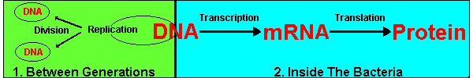
Overview

Slide 4
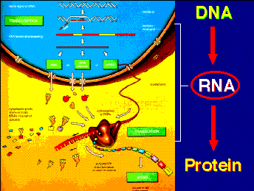

Slide 5
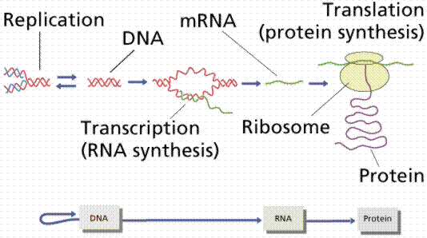
Summary

Slide 6
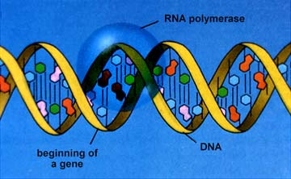
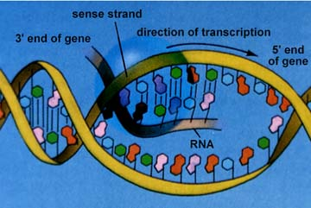
Transcription 1
(making a mRNA copy of DNA)
The part of the DNA molecule (the gene) that the cell wants the information from to make a protein unwinds to expose the bases.
Free mRNA nucleotides in the nucleus base pair with one strand of the unwound DNA molecule.

Slide 7
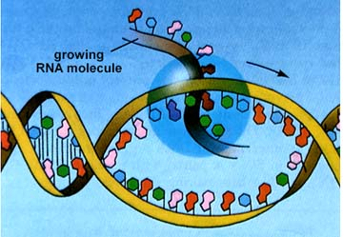
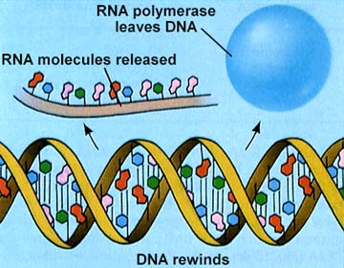
Transcription 2
The mRNA copy is made with the help of RNA polymerase. This enzyme joins up the mRNA nucleotides to make a mRNA strand.
This mRNA strand is a complementary copy of the DNA (gene)
The mRNA molecule leaves the nucleus via a nuclear pore into the cytoplasm

Slide 8
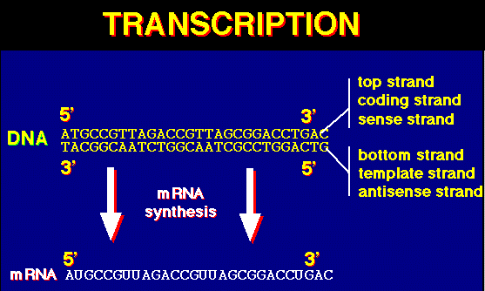

Slide 9
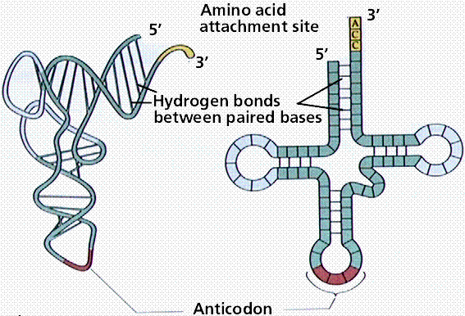
tRNA – pick up their specific amino acids from the cytoplasm

Slide 10
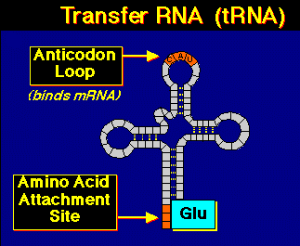

Slide 11
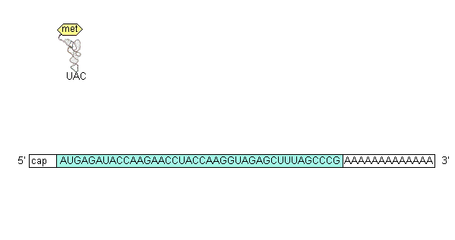
Translation - animation

Slide 12
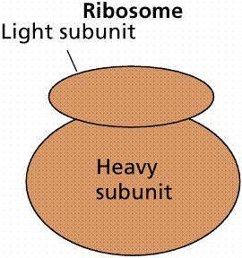
mRNA attaches to small ribosomal subunit

Slide 13
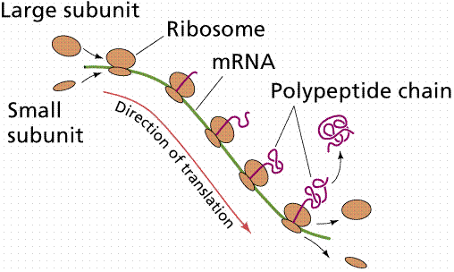
Translation - outline

Slide 14
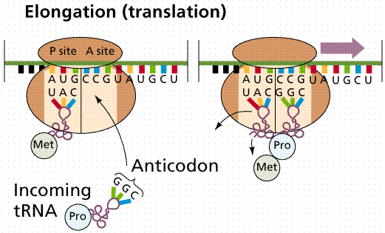
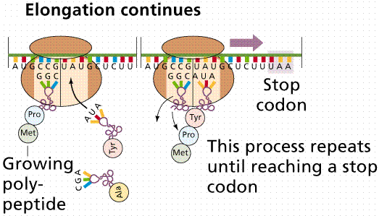
Translation.
mRNA used to make polypeptide chain (protein)

Slide 15
1.
First the mRNA attaches itself to a ribosome (to the small subunit).
Six bases of the mRNA are exposed.
A complementary tRNA molecule with its attached amino acid (methionine) base pairs via its anticodon UAC with the AUG on the mRNA in the first position P.
Another tRNA base pairs with the other three mRNA bases in the ribosome at position A.
The enzyme peptidyl transferase forms a peptide bond between the two amino acids.
The first tRNA (without its amino acid) leaves the ribosome.

Slide 16
Translation 2
The ribosome moves along the mRNA to the next codon (three bases).
The second tRNA molecule moves into position P.
Another tRNA molecule pairs with the mRNA in position A bringing its amino acid.
A growing polypeptide is formed in this way until a stop codon is reached.

Slide 17
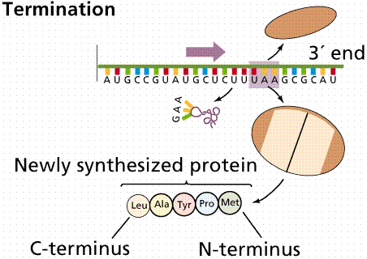
End of Translation
A stop codon on the mRNA is reached and this signals the ribosome to leave the mRNA. A newly synthesised protein is now complete!

Slide 18
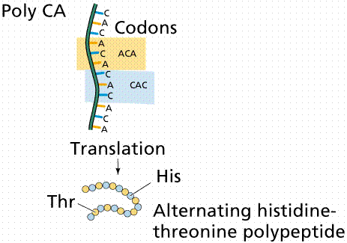
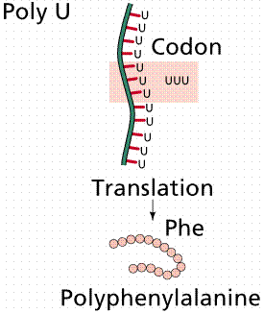
Translation mRNA to Polypeptide

Slide 19
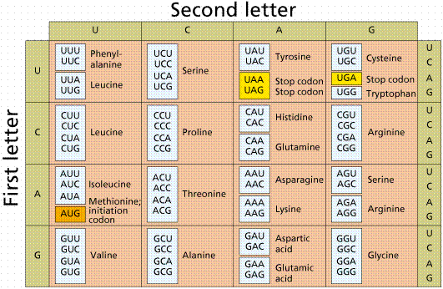

Slide 20
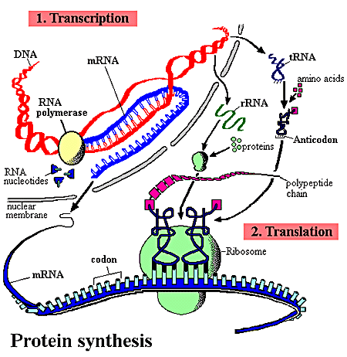


Slide 21
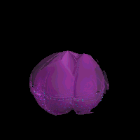
Rough endoplasmic reticulum

Slide 22


Slide 23

One ribosome from the RER

Slide 24
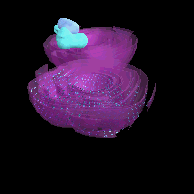

Slide 25
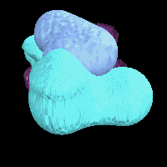
A ribosome

Slide 26
This powerpoint was kindly donated to www.worldofteaching.com
http://www.worldofteaching.com is home to over a thousand powerpoints submitted by teachers. This is a completely free site and requires no registration. Please visit and I hope it will help in your teaching.

